Slide 1
Hazards Associated With Illegal Discharges
GCSA Employee Training
Nienhuis Park Community Center
May 19, 2017
Richard Smith, Stormwater Consultant

Slide 2
Training Required On “Illegal Discharges”
OKR04 Part IV.C.3.a(6) Inform public employees, businesses, and the general public of hazards associated with illegal discharges and improper disposal of waste. Promote, publicize and facilitate the reporting of illicit discharges. [Required]
40 CFR Part 122.26(b)(2) Illicit discharge means any discharge to a municipal separate storm sewer that is not composed entirely of storm water …
“Illicit” means “Illegal” for training purposes.

Slide 3
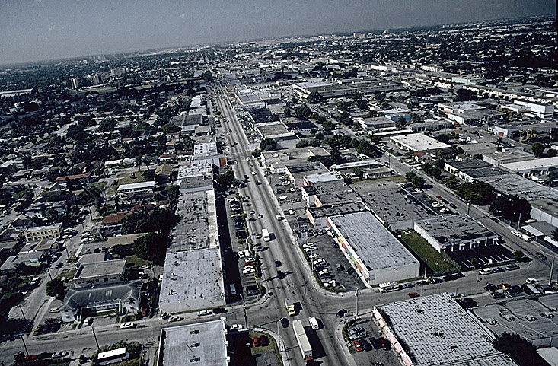
Common Pollutants in Urban Stormwater
Sediment
Nutrients
Oxygen-Demanding Substances
Pathogens
Trash
Yard Waste
Road Salts
Oil and Grease
Heavy Metals
Heat
Petroleum
Pesticides
Other organics

Slide 4
Types of Human Health Hazards
Toxic (poisonous)
Pathogenic (disease-causing)
Carcinogenic (cancer-causing)
Mutagenic (causing genetic mutations)
Teratogenic (birth defects, congenital defects)
Neurological (damage / diseases of the nervous system)
Physical injury (corrosive, blinding, breathing, etc.)
Flammable or explosive (ignites or explodes)

Slide 5
Human Exposure Pathways and Quantities
  Solids, liquids, gases in mixtures, devices, containers.
  May be mixed into innocent-looking materials.
  Some in even tiny amounts are harmful / deadly.
  May have no symptoms for days (e.g., pathogens).
  May be invisible, odorless, tasteless (e.g., H₂S, radiation).
  Pathways: Ingestion, inhalation, body contact.
  May have no or incorrect container labels / information.
  Synergism (multiplying affect of 2 or more substances).

Slide 6
How To Know What You Are Facing
  Hundreds of thousands of chemicals on the market.
  Most do not have fully known human health or environmental effects.
  Many Illicit Discharges (IDs) in stormwater involve unknown substances.
  Typical IDDE field test kits will not detect specific IDs.
  Look for labels on containers; contact property owners.
  If you are uncertain about what the substance is, back off, protect area from others, contact local HAZMAT.

Slide 7
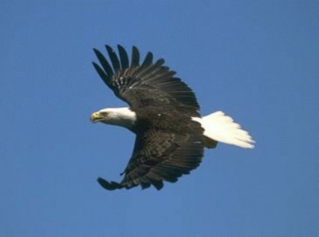
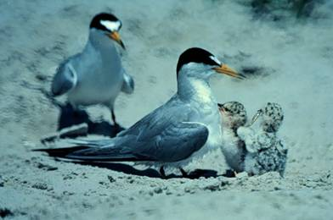
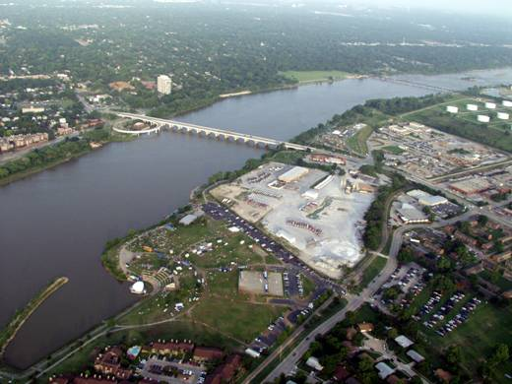
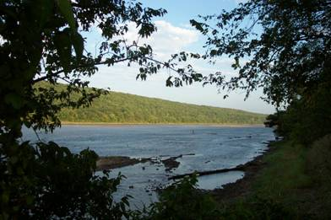
Environmental Effects of Illegal Discharges
  Water Quality Standards (WQS) address toxicity and pathogenicity (non-physical hazards like explosions).
  Each waterbody in Oklahoma has a list of how the water resources are being used, called “Beneficial Uses” (BUs).
  Oklahoma’s WQS protect BUs with numerical and narrative criteria.

Slide 8
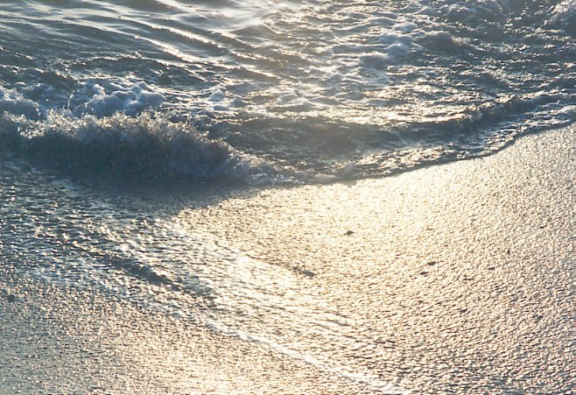
Oklahoma’s WQS Beneficial Uses
Public and Private Water Supply
Emergency Water Supply
Fish and Wildlife Propagation
  Habitat Limited Aquatic Community
  Warm Water Aquatic Community
  Cool Water Aquatic Community
Recreation (Primary and Secondary Body Contact)
Agriculture: Livestock and Irrigation
Navigation
Aesthetics
Fish Consumption (fish, water & fish)
BU combinations are designated for every waterbody in the State.

Slide 9
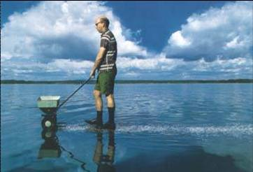
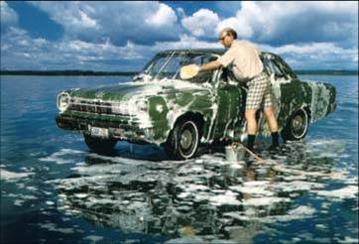
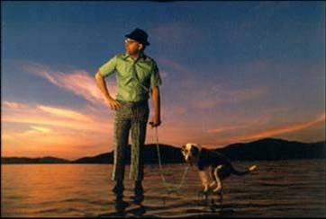
Environmental Effects of Water Pollution
Human Consumption
Aquatic Life / Fisheries
Aquatic Habitat
Water Recreation
Aesthetics of Water Resources
Drinking Water Supplies
Industrial Use & Navigation
Agricultural Use
Cultural Use

Slide 10
Pollutant Category Environmental Impacts
Heavy Metals – neurotoxins, systemic pathology.
Organics – neurotoxins, systemic pathology, poisons.
Nutrients – nuisance algal growth, low dissolved oxygen.
Sediment – lost habitat, clogs fish gills, adsorbed toxics.
pH – impairs life functions of aquatic organisms.
Salinity – excess salt harms sensitive organisms.
Pathogens – diseases in humans and aquatic organisms.

Slide 11
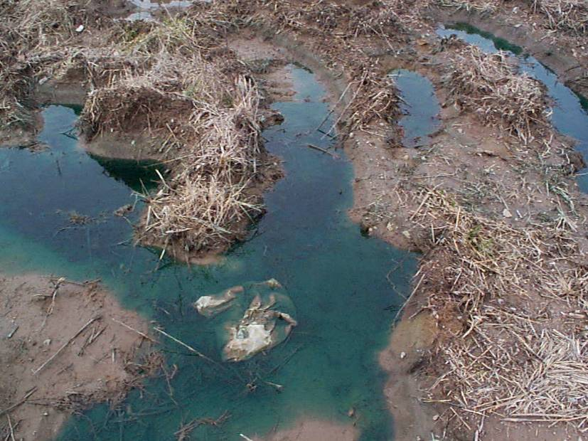
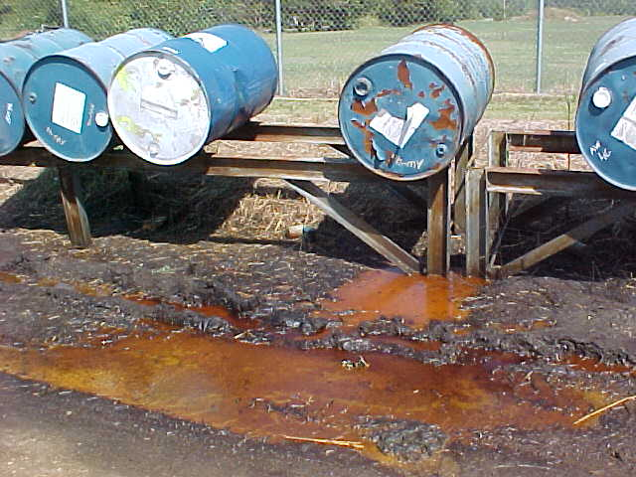
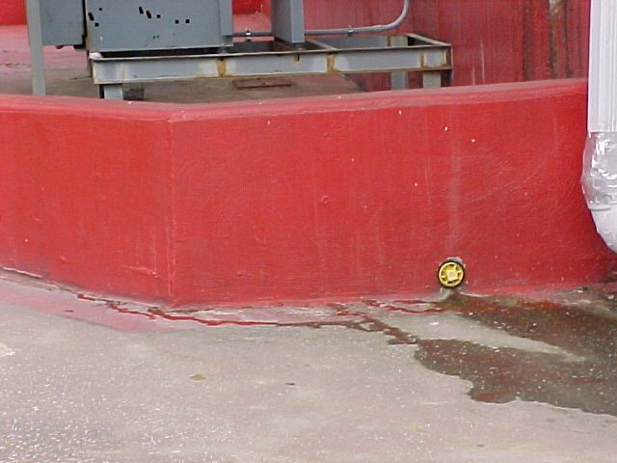
Pollutants from Local Businesses
What most people think are the greatest sources of pollution.
Industrial and Commercial Sites
Large and Small businesses

Slide 12
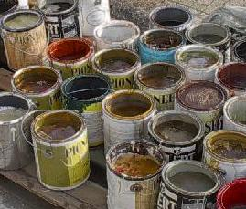
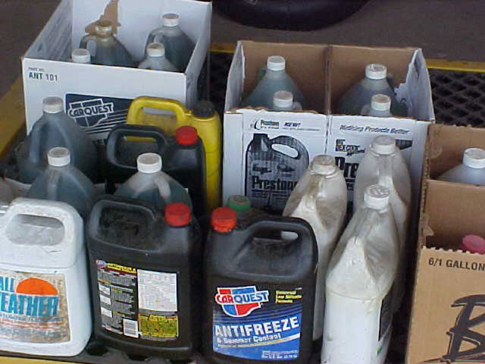

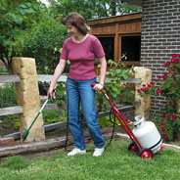
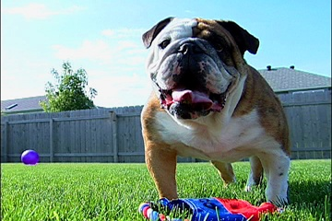
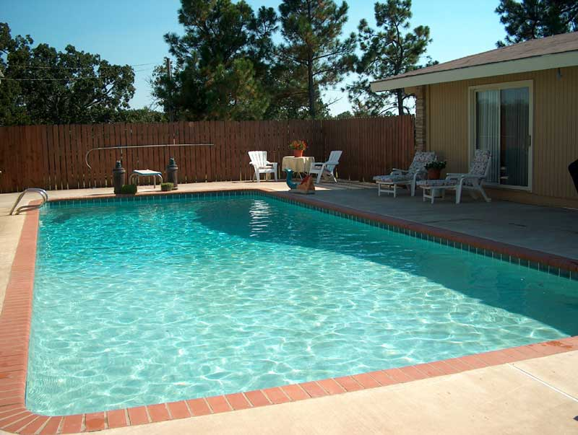
Pollutants from Homes
Paints and solvents
Toxics
Nutrients
Sediment
pH
Oils
Pathogens
O₂ demand
Oils and antifreeze
Yard waste: grass clippings, leaves
Fertilizers and pesticides
Pet waste (pathogens)
Swimming pool drain water with chlorine
12

Slide 13
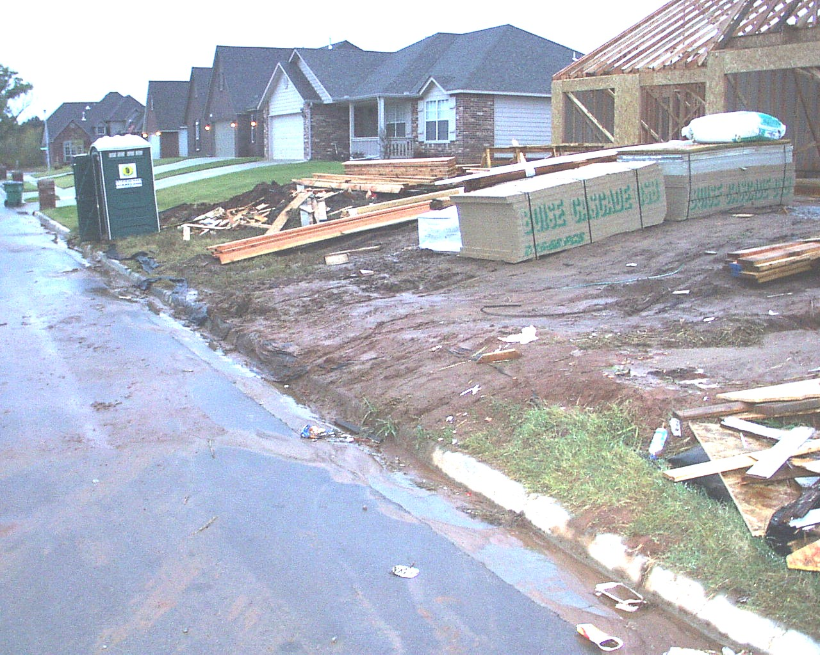
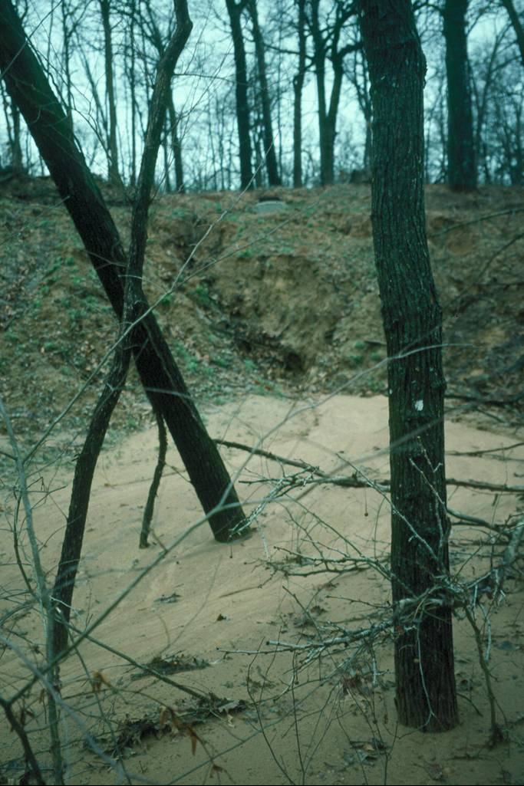
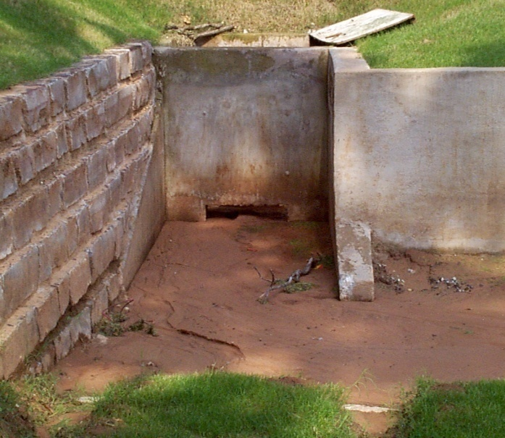
Pollutants from Construction Sites
From Site…
To Stormdrain…
Sediment Build-up
Can Harm Stream Habitat
To Local Creek

Slide 14
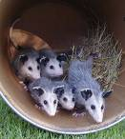
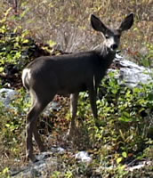
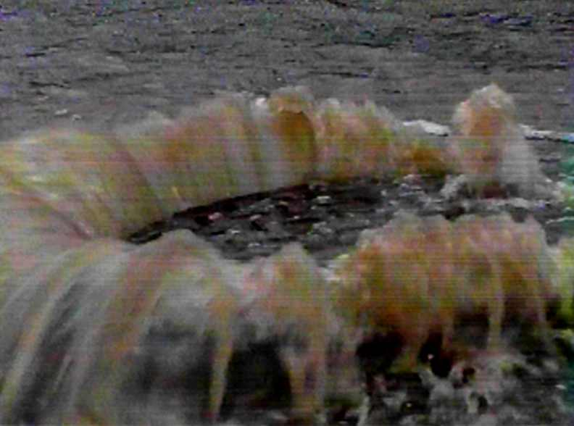
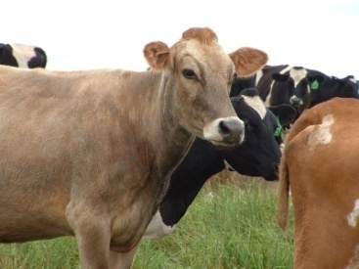

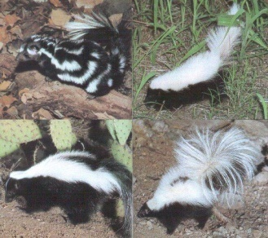
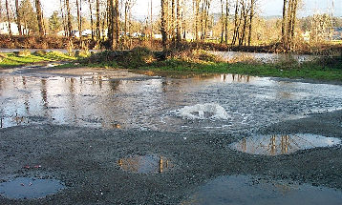
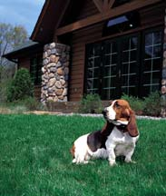
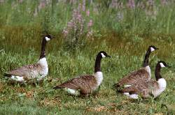
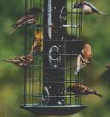
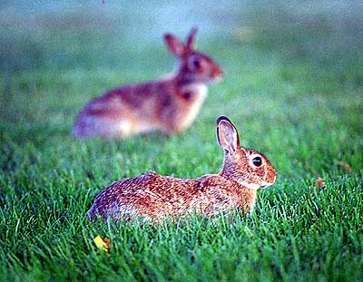
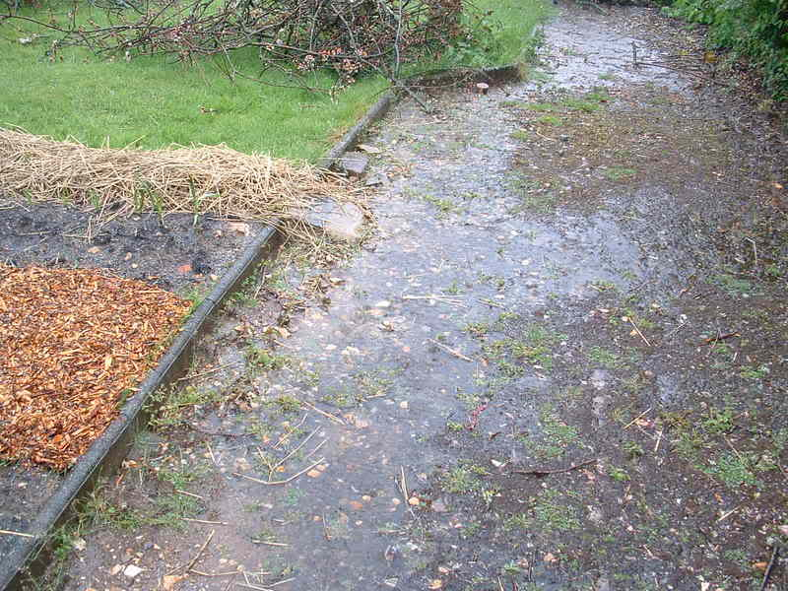

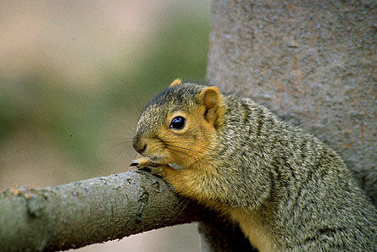
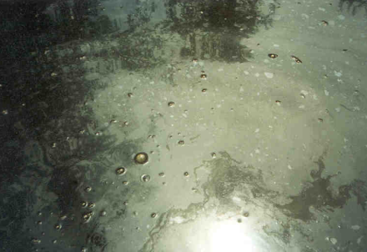
Potential Urban Bacteria Sources
Controllable
Partly Controllable
Uncontrollable
Regrowth

Slide 15
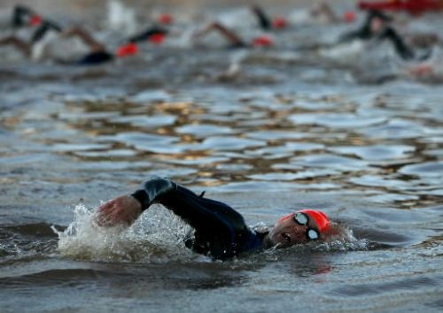
“Oklahoma River Water Caused Illness”
Tulsa World, June 10, 2009
By MURRAY EVANS Associated Press
OKLAHOMA CITY — Parasites, viruses and bacteria in the Oklahoma River were to blame for sickening dozens of participants in an international triathlon held last month, state health officials said Wednesday.
At least 45 participants in the Boathouse International Triathlon in Oklahoma City became sick with gastrointestinal problems after the event held May 16-17.
The Oklahoma State Department of Health said the illness was related to exposure to water during swimming practice sessions or during the swim portion of the event.
E. Coli = 573 col/100 mL
Standard = 126 col/100 mL

Slide 16
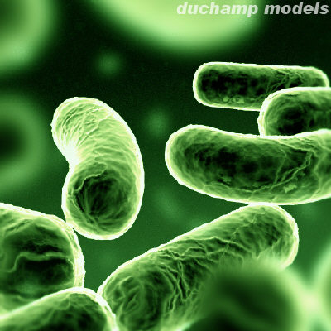

Difficult to Control Bacteria in Urban Areas
Most urban bacteria TMDLs and studies show animals as the primary sources:
  Pets (dogs and cats)
  Wildlife (small birds and critters)
  Migratory, non-migratory large birds (geese, ducks)
  Livestock in urban areas
Most WWTP discharges are now disinfected.
Human sewage (bypasses) are inevitable.
Regrowth in stream beds and MS4 pipes.

Slide 17
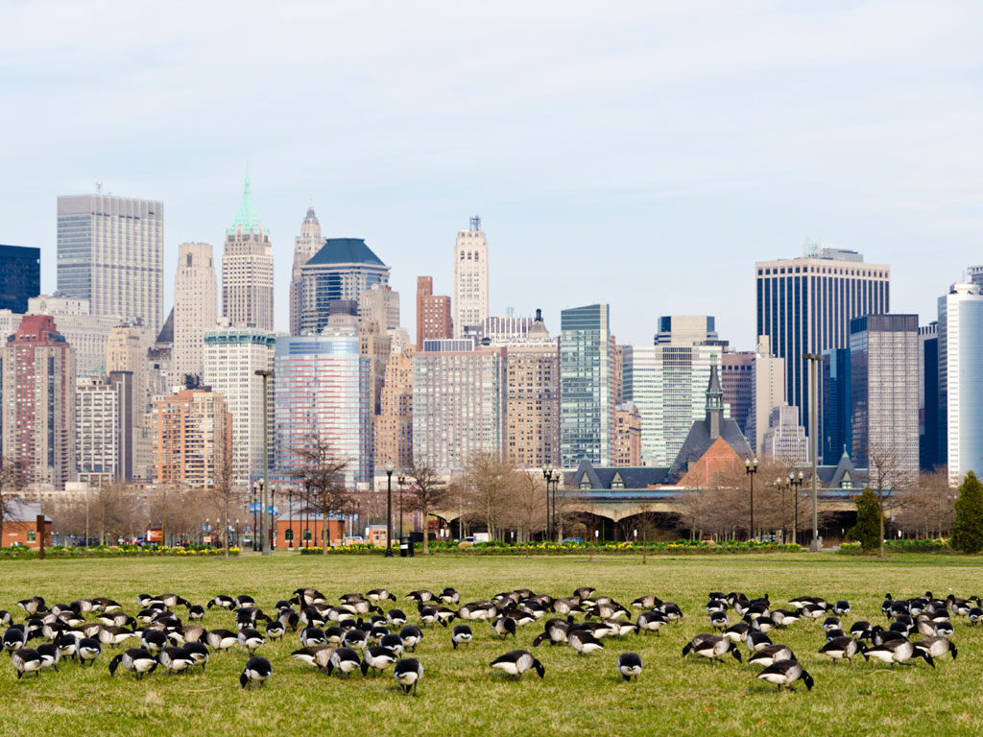
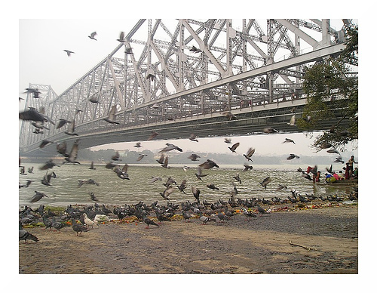
Urban Areas Attract Wildlife
Many animals are attracted to water courses:
  Detention ponds
  Creeks
  Natural ponds
  Urban wetlands
  Drainage ditches with standing water
Riparian areas next to water attract animals.
Direct deposition of feces in riparian areas and water courses increases bacteria loads.

Slide 18
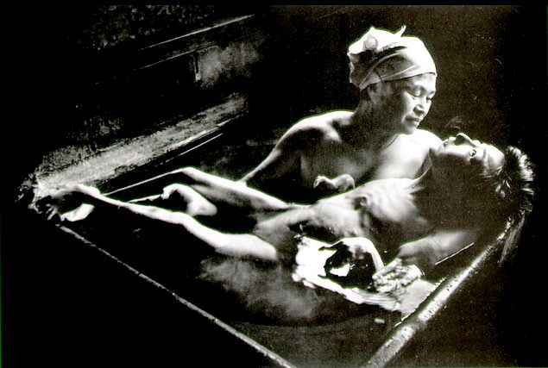
Water Pollution Tragedy – Methylmercury Effects
Minamata Bay, Japan - ca 1968
Mercury is a neurotoxin.
Industrial pollution in fishing bay.
Entire village affected by this tragedy.
Mother with 17 year old daughter.

Slide 19
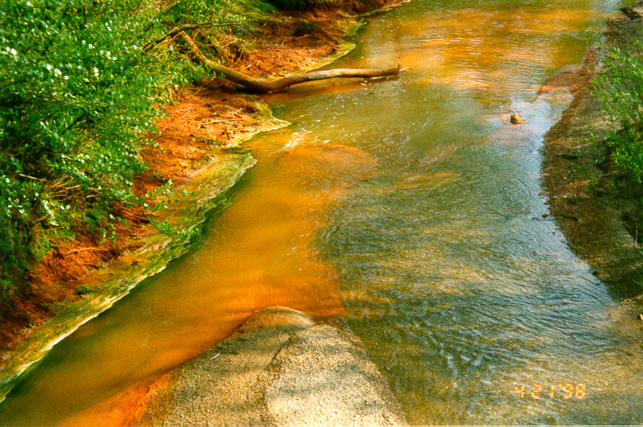
Acid Mine Drainage – Heavy Metal Toxicity
Low pH.
Lead, Zinc, more...
Essentially a sterilized stream.
Extremely costly and difficult to clean up.
City of Tulsa Photo.

Slide 20
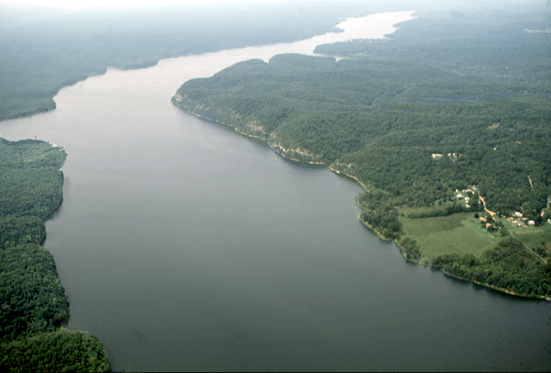

Excess Nutrients in Drinking Water Source
Even years of litigation may not solve problem.
City of Tulsa Photos.
Corporate agri-business was main nutrient source.

Slide 21
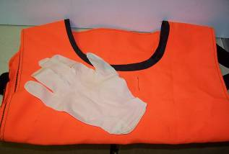
Personal Gear
Storm water field crews should be equipped, at a minimum, with the following gear:
Safety vests (reflective)
Proper footwear (boots, waders, safety shoes)
Personal flotation devices (PFD)
Gloves (rubber, leather)
Safety glasses, goggles or face shield
Emergency first aid kit

Slide 22





Questions ??
Vernon Seaman
Manager, Envir. And Energy Planning
INCOG
Two West 2nd Street, Ste 800
Tulsa, OK 74103
(918) 579-9451
vseaman@incog.org

